Slide 1
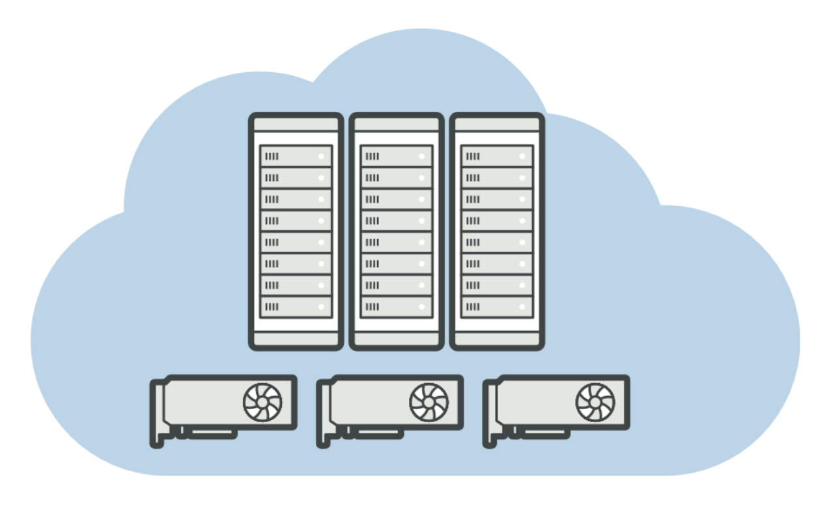

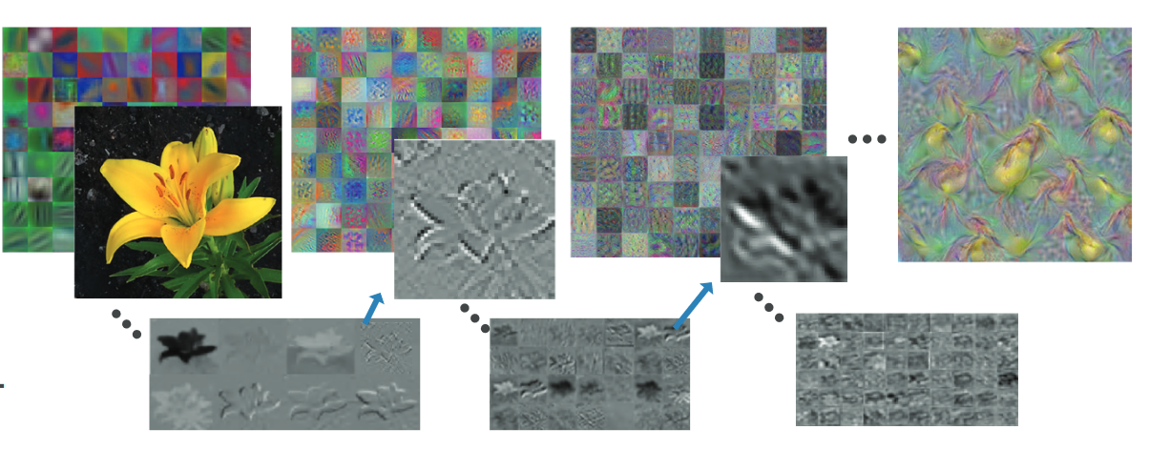
Deep Learning A Practical Approach in MATLAB
David Willingham Senior Data Analytics Engineer
david.willingham@mathworks.com

Slide 2
WITH SOFTWARE
(and smart people)
ANYTHING IS POSSIBLE

Slide 3
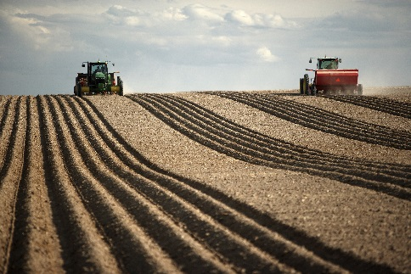
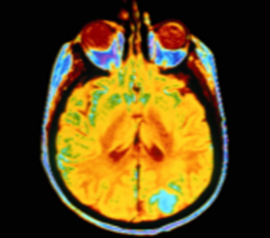
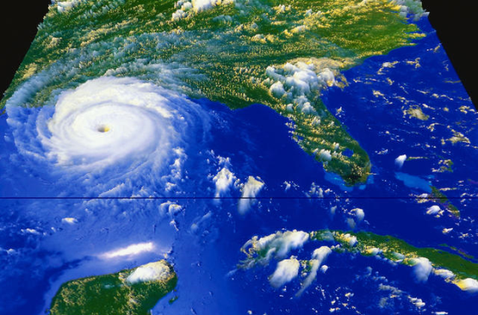
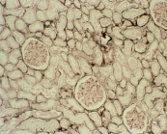
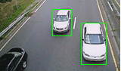
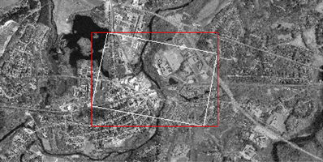
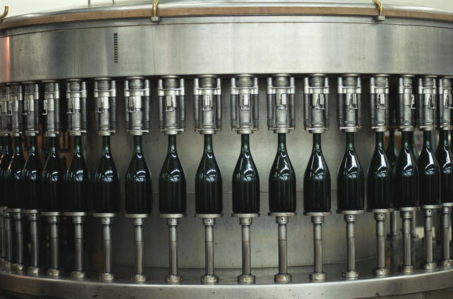
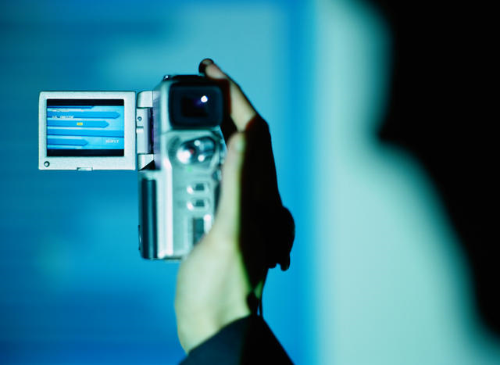
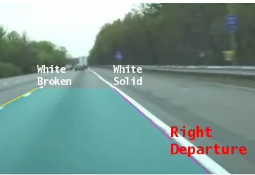
Artificial Intelligence is Everywhere
Image Recognition
Speech Recognition
Stock Prediction
Medical Diagnosis
Data Analytics
Robotics
and more…
[TBD]
Notes:
Machine Learning is ubiquitous.
From medical diagnosis, speech and handwriting recognition to automated trading and movie recommendations machine learning techniques are being used to make critical business and life decisions every moment of the day. Every machine learning problem is different and it can be challenging to manage raw data, identify key features that impact your model, training multiple models and performing model assessments.

Slide 5
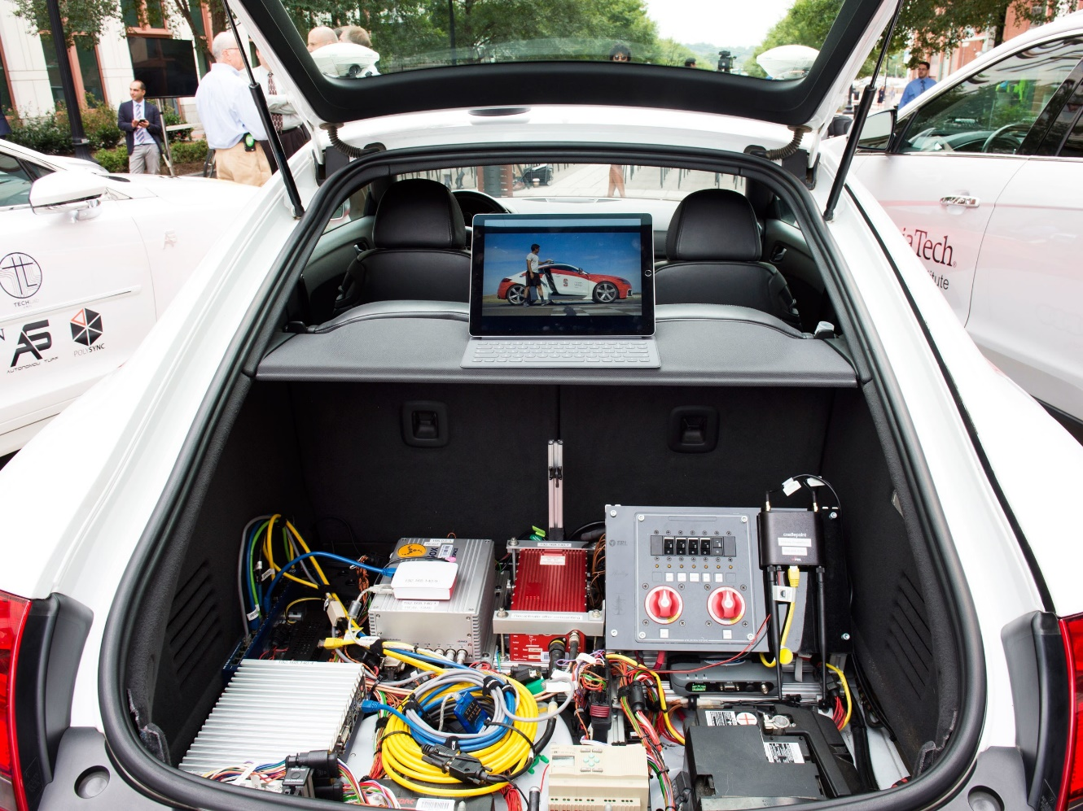
What's in the trunk (aka boot) of an autonomous vehicle?
SELF-DRIVING CARS USE CRAZY AMOUNTS OF POWER, AND IT'S BECOMING A PROBLEM – Wired 6/2/2018

Slide 6


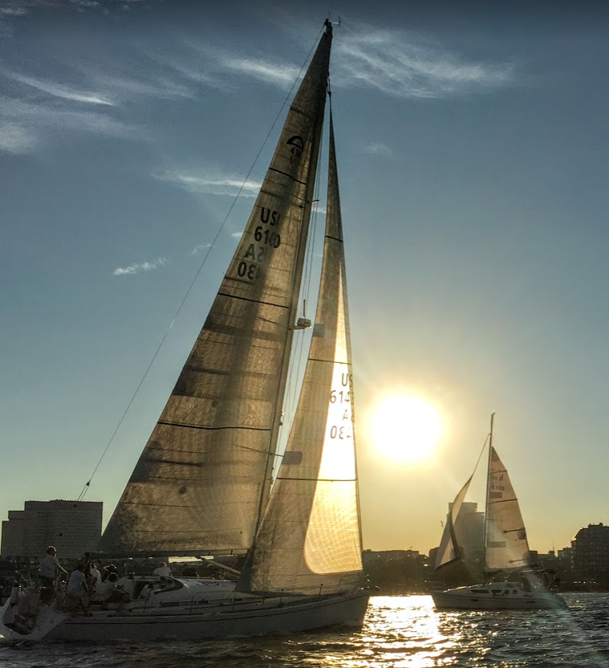
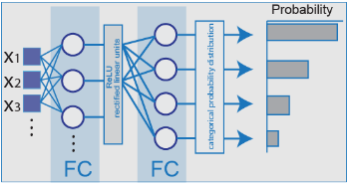

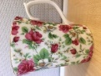
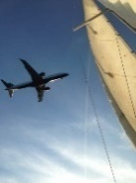
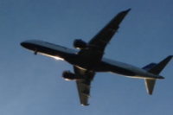
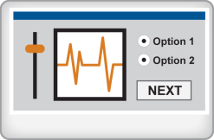
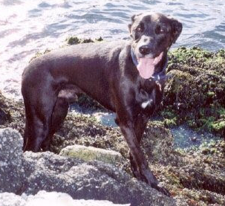

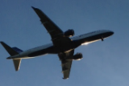
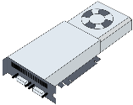
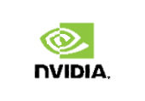

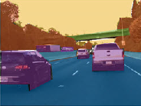
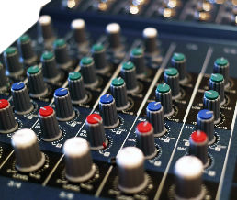
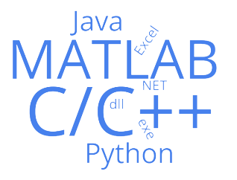
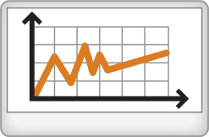

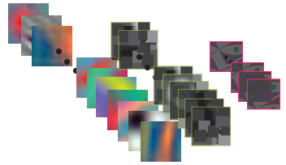
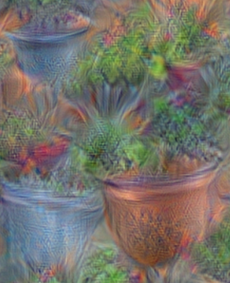
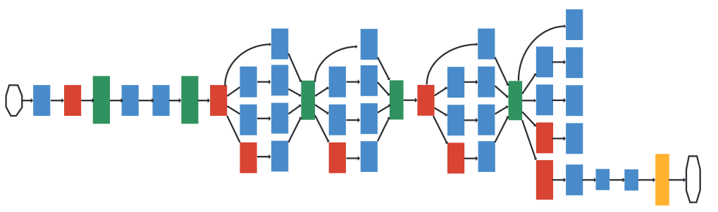


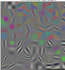


Deep Learning - end to end product development
Access and Explore Data
Label and Preprocess Data
Develop Predictive Models
Integrate Models with Systems
Files
Clean Data
Train
Desktop Apps
Databases
Feature Engineering
Tune
Web Based Systems
Sensors
Select Model
Visualise
On Device

Slide 7

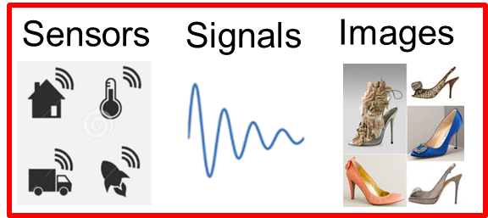
Data Access
MATLAB Analytics work with business and engineering data
Business and Transactional Data
Engineering, Scientific, and Field Data
Repositories
Databases (SQL)
NoSQL
Hadoop
File I/O
Text
Spreadsheet
XML
Web Sources
RESTful
JSON
HTML
Mapping
Financial datafeeds
File I/O
Text
Spreadsheet
XML
CDF/HDF
Image
Audio
Video
Geospatial
Communication Protocols
CAN (Controller Area Network)
DDS (Data Distribution Service)
OPC (OLE for Process Control)
XCP (eXplicit Control Protocol)
Real-Time Sources
Sensors
GPS
Instrumentation
Cameras
Communication systems
Machines (embedded systems)
Cloud
Amazon S3
Azure Blob
Streaming
Amazon Kinesis
Azure Event Hub
Kafka
MQTT

Slide 8
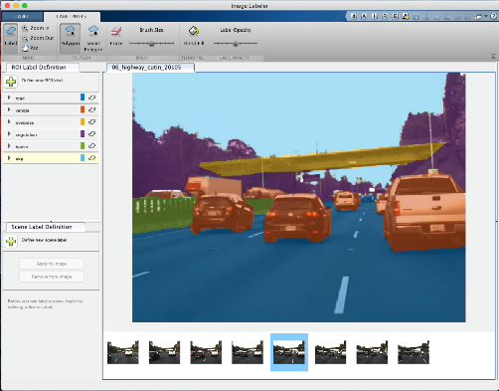
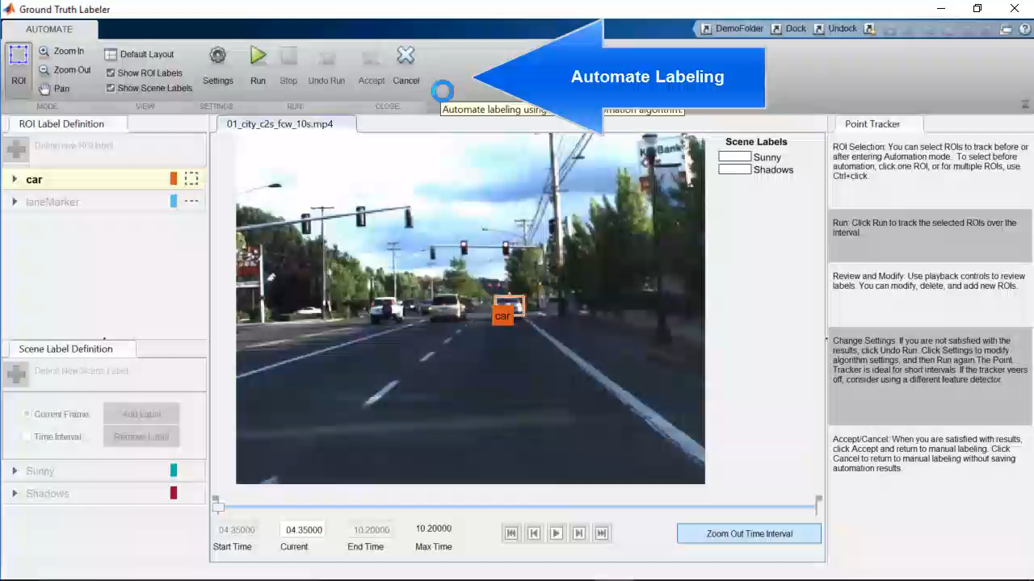
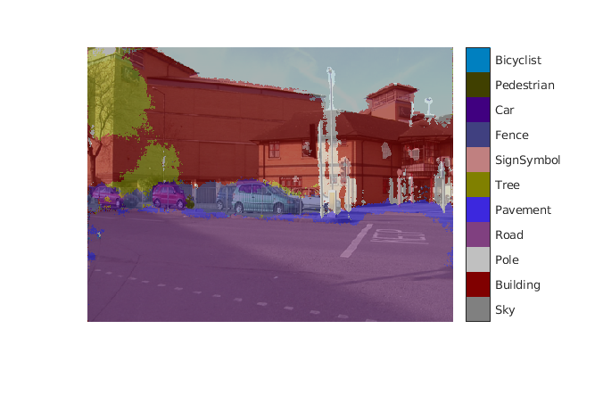
Pre Processing – MATLAB Automated Ground truth Labeling
New App for Ground Truth Labeling
Automatically Create your own library of images from Video
Label pixels and regions for semantic segmentation
Notes:
Depending on the application, you could have thousands or millions of example images available to you. But in order to learn what an object is, the image must be of the object only, no background or other objects that could confuse it. Take a car for example, in order to train a network on what a car is, you have to crop and identify only the location of the car. Imagine having to do that for a million images one by one.
(CLICK) So here’s a video of how MATLAB makes this task easier. You identify one car in a video, and then MATLAB will track the car over many frames in the video. You now have 100 examples of car that can be used for training. Imagine having to do that without this app.
**if time, rework video to actually show cropping

Slide 9
Detection and localization using deep learning
Regions with Convolutional Neural Network Features (R-CNN)
Semantic Segmentation using SegNet

Slide 10
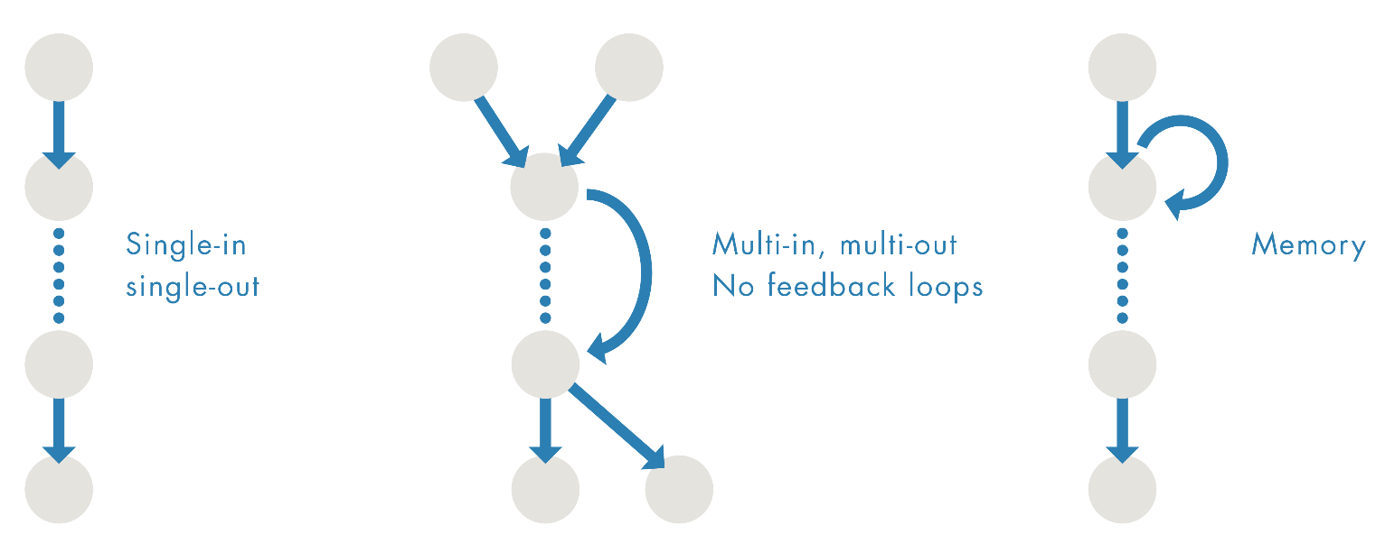
Deep Learning Model Support
SeriesNetwork
DAGNetwork
Recurrent Network
Networks: MNIST
Alexnet
VGG
Lane detection
Pedestrian detection
Networks: R-CNN (fast, faster)
GoogLeNet
ResNet
SegNet
FCN
DeconvNet
Networks: LSTM (timeseries)
Object detection
Semantic segmentation

Slide 11
Import the Latest Models for Transfer Learning
Pretrained Models*
AlexNet
VGG-16
VGG-19
GoogLeNet
InceptionV3
Resnet50
* single line of code to access model
Import Models from Frameworks
Caffe Model Importer
TensorFlow/Keras Model Importer
AlexNet
PRETRAINED MODEL
Caffe
Models
VGG-16
Pretrained Model
GoogLeNet
Pretrained Model
ResNet
Pretrained Model
TensorFlow/Keras
Models

Slide 12
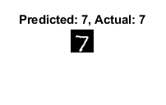
Deep Learning – In 5 lines of MATLAB code
load chardata
layers = createLayers;
options = trainingOptions( 'sgdm','MiniBatchSize', 8192,'Plots', 'training-progress','ExecutionEnvironment’,’multi-gpu’);
net = trainNetwork(imgDataTrain, labelsTrain, layers, options);
predLabelsTest = net.classify(imgDataTest);

Slide 13
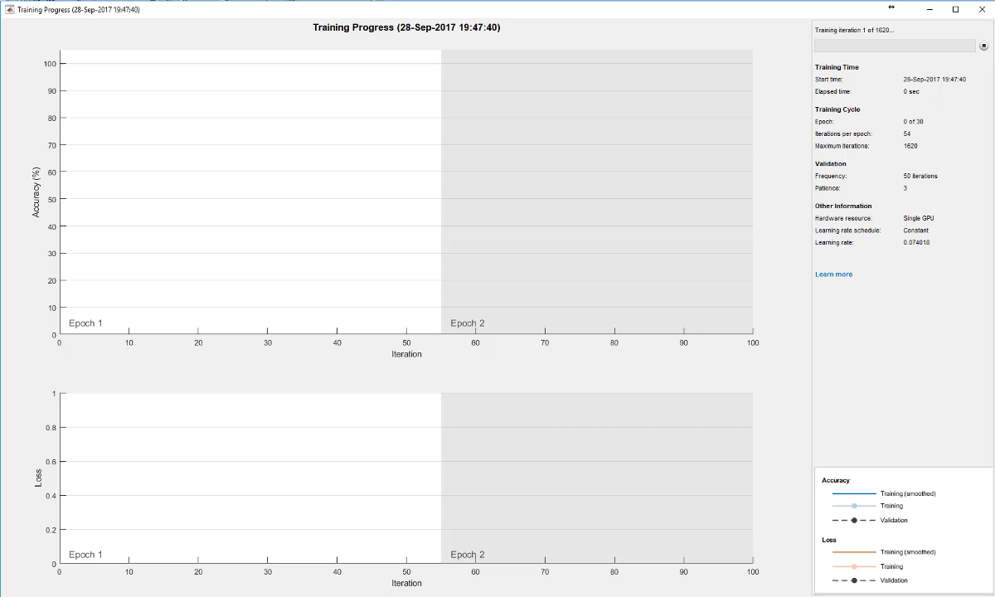
Live Training Progress

Slide 14
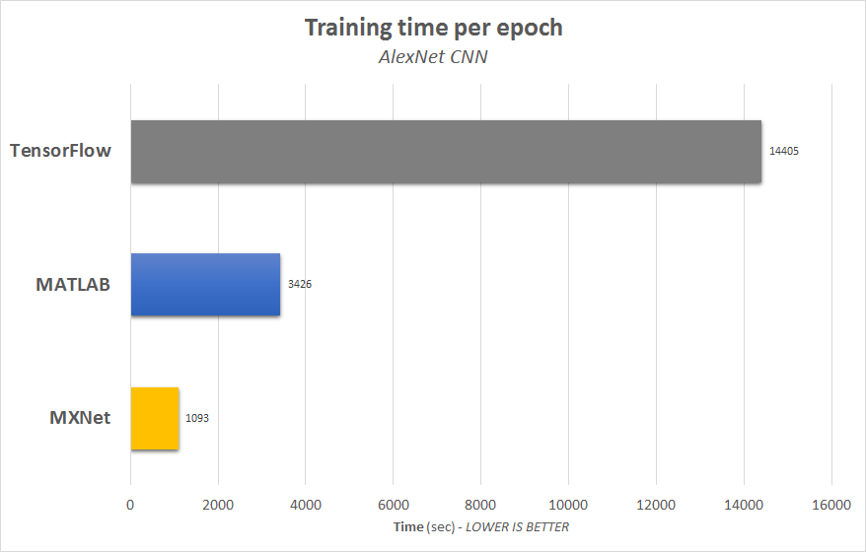
Training in MATLAB is fast
MATLAB is more than 4x faster than TensorFlow
AlexNet CNN architecture trained on the ImageNet dataset, using batch size of 32, on a Windows 10 desktop with single NVIDIA GPU

Slide 15
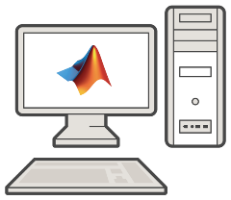

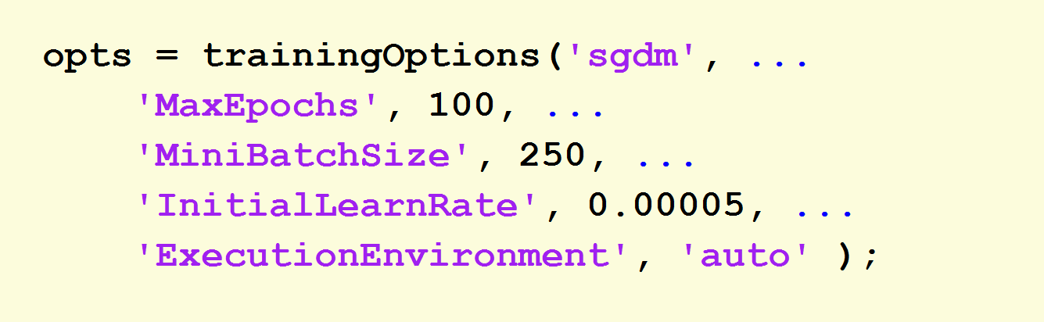

Deep learning on CPU, GPU, multi-GPU and clusters
How to target?
Single CPU
Single GPU
Single CPU

Slide 16
Deep learning on CPU, GPU, multi-GPU and clusters
How to target?
Single CPU
Multiple GPUs

Slide 17


Deep learning on CPU, GPU, multi-GPU and clusters
How to target?
On-prem server with GPUs
Cloud GPUs
(AWS, Azure, etc.)

Slide 18
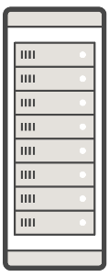




Deep learning on CPU, GPU, multi-GPU and clusters
More CPUs
More GPUs

Slide 19
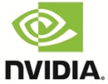
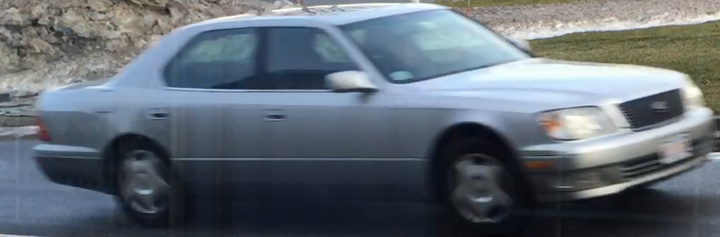
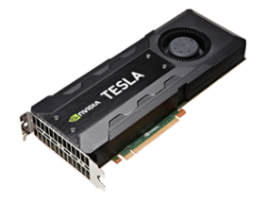
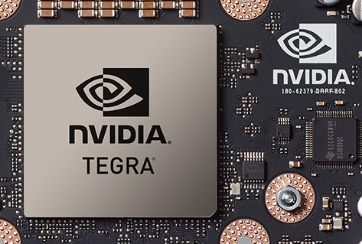

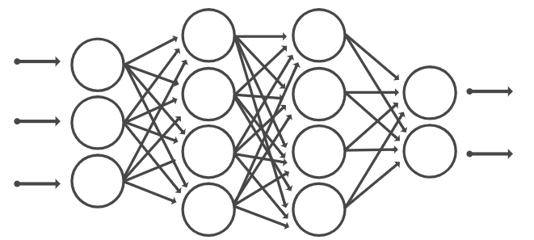
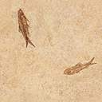
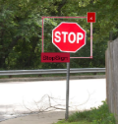
Deep Learning Deployment Options
`
Access Data
Preprocess
Select Network
Train
Deploy
Image Acq.
Image Processing
Neural
Network
PCT
GPU
Coder
Desktop
Web/Cloud
Computer
Vision
Notes:
You’ve heard about deep learning from your customers and also at MathWorks
We’ve moved to create tools to address deep learning, but customers want to move designs to NVIDIA GPUs
GPU Coder fills in the missing piece
GPU Coder is for inference, not training
Training is required, and you will need a lot of data for the training phase; this step is to train the deep learning network to give the right answer
Inference = predict. Once the deep learning network has been trained, you can deploy it to a piece of hardware, give it inputs, and it will “predict”/infer the right answer
Use PCT to train deep learning networks

Slide 20
Running a Trained Model
“How do I make my model run faster?”
30 fps
MATLAB 2.5x
faster than Tensorflow
10 fps
* Internal benchmarks were performed for inference performance of AlexNet using a TitanXP GPU and Intel(R) Xeon(R) CPU E5-1650 v4 @ 3.60GHz. Software versions used were MATLAB(R2017b), TensorFlow(1.2.0), and Caffe2(0.8.1). The GPU accelerated versions of each software were used for benchmarks. All tests were run on Windows 10.
Notes:
We now have a trained model, and can run this on new images and video. Speed of prediction is also important in deep learning.
(CLICK). Would you rather have a model running in the top video or the bottom?
(CLICK) The difference is 30 frames per second vs. 10.
(CLICK) MATLAB faster than the competition. (CLICK) 2.5 times faster than Tensorflow, which is an alternative framework for deep learning

Slide 21
Running a Trained Model
7x faster than TensorFlow and 4.5x faster than Caffe2
GPU Coder- Convert to NVIDIA CUDA code
Notes:
For even faster results, we’ve introduced a new product in 17b called GPU coder, which produces highly optimized code. It’s the most efficient code to date, which achieves up to 7x better performance than TensorFlow and 4.5x better performance than Caffee2 for deployed models.

Slide 22
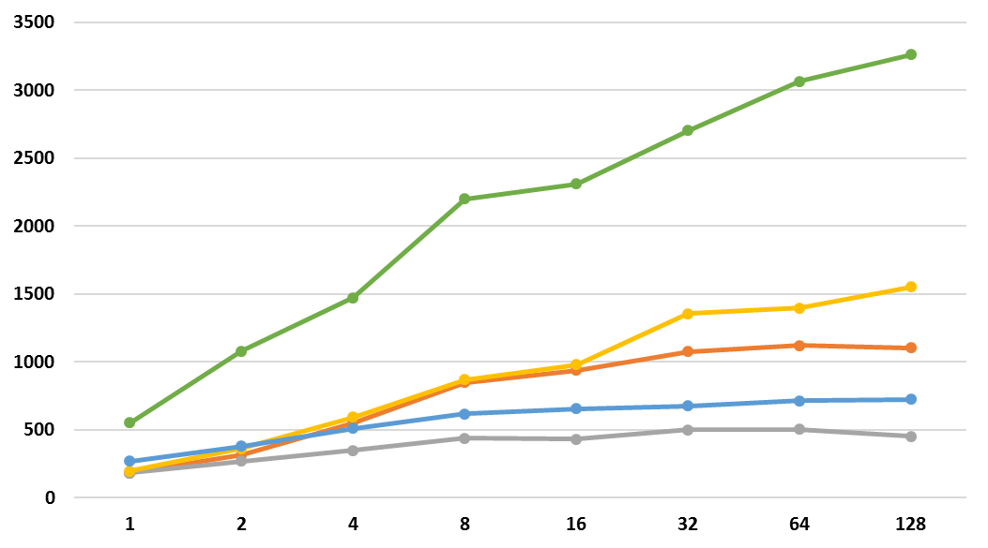
AlexNet Inference on NVIDIA Titan XP GPU
GPU Coder
Frames per second
mxNet
MATLAB
Caffe2
TensorFlow
Batch Size
Testing platform
CPU | Intel(R) Xeon(R) CPU E5-1650 v3 @ 3.50GHz
GPU | Pascal TitanXP

Slide 23
MATLAB GPU Coder

Slide 24
More Deployment options coming
Android phone

Slide 25
Deep Learning - end to end product development
Access and Explore Data
Label and Preprocess Data
Develop Predictive Models
Integrate Models with Systems
Files
Clean Data
Train
Desktop Apps
Databases
Feature Engineering
Tune
Web Based Systems
Sensors
Select Model
Visualise
On Device

Slide 26
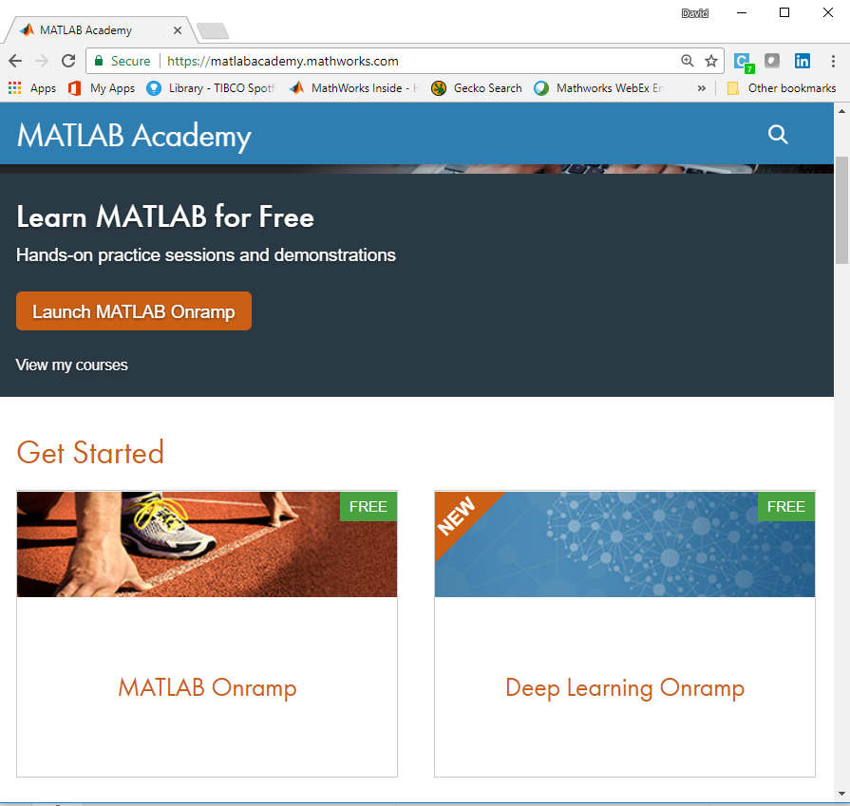
More Resources - Learn Deep Learning for free

Slide 27

MathWorks can help you do Deep Learning
Free resources
Other options
Guided evaluations with a MathWorks deep learning engineer
Proof-of-concept projects
FREE online Deep learning ramp up
Seminars and technical deep dives
Documentation and user community
Consulting services
Training courses
Technical support
Advanced customer support
Installation, enterprise, and cloud deployment
Deep Learning: Top 7 Ways to Get Started with MATLAB

